Slide 1
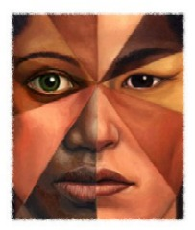
Culturally and Linguistically Diverse
Lindsey Kane
Katelyn Mikle
Holly Phillipkosky
Katie Pardee

Slide 2
Word Sort
Using the slips of paper to categorize the characteristics/assumptions for each culture based on your own personal experiences.

Slide 3
Video Clip
http://www.youtube.com/watch?v=uV36efjBKRU
http://www.youtube.com/watch?v=3irqd73SPe4
http://www.youtube.com/watch?v=E1MI_h0HIcw
http://www.youtube.com/watch?v=BT0kzF4A-WQ

Slide 4
Clip- Lost Boys
http://www.youtube.com/watch?v=BT0kzF4A-WQ

Slide 5
Definition: Who are the culturally/linguistically diverse?

Slide 6
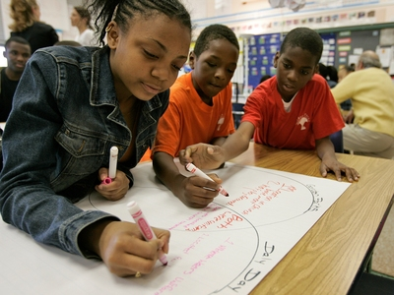
1st Population- African Americans

Slide 7
Characteristics/Assumptions
Spirituality- hold deep belief and systems; values spiritual activities
Harmony- feel that self and environment are interconnected
Oral Tradition- gain and transmit knowledge orally
Affect- Value and trust emotionally gained information rather than cognitive learning
Verve-Understand by performing
Movement- organized through movement
Expressed Individualism- Entertaining
Social Time- time with friends

Slide 8
Learning Opportunities
Use small groups for instruction
Provide structure by establishing clear goals
Provide successful African Americans as mentors
Emphasize the use of oral language
Provide visual learning experiences

Slide 9
S-C-L (Stop-Collaborate- Listen)

Slide 10
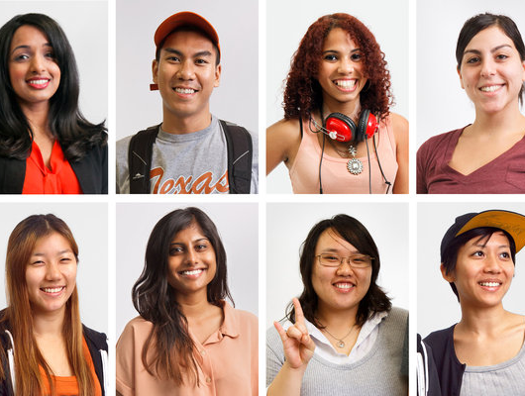
2nd Population- Asian Americans

Slide 11
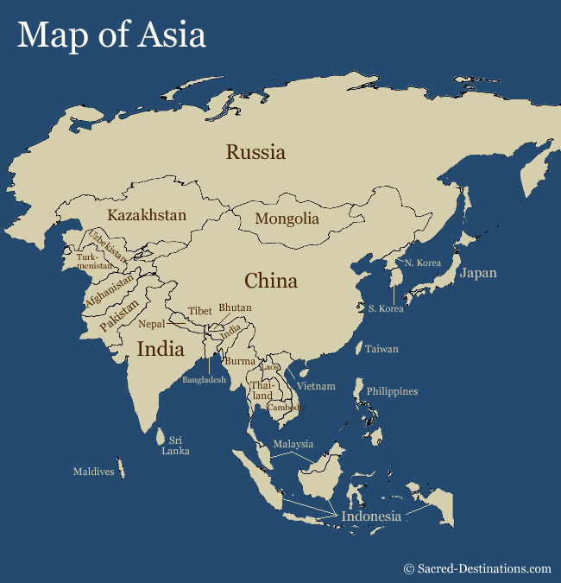

Slide 12
Characteristics/Assumptions
Quiet Nature
Serious and caring attitudes towards their families and to teachers and adults
Self discipline
Self motivation- driven to work hard
Learn best from memorization and drill

Slide 13
Learning Opportunities
Learn in teams and small groups
Use intuition in learning
Provide visual experiences
Encourage expression verbally and in writing

Slide 14
S-C-L

Slide 15
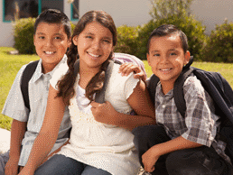
3rd Population- Native Americans

Slide 16
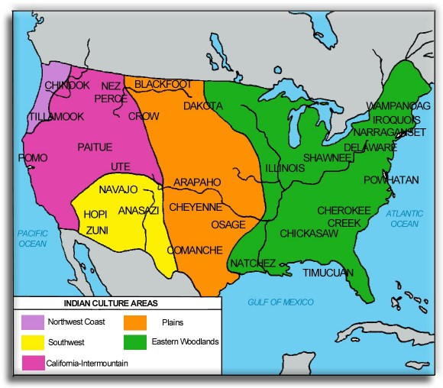

Slide 17
Characteristics/Assumptions
Work well in groups
Good mediators
Communicate effectively
Express understanding through visual (art, story, poems, legends)
Creative
Accepts responsibility
Can be resourceful
Excellent memory and spatial ability
Often do not seek attention

Slide 18
Learning Opportunities
Develop personal and group relative to tribe and student belief
Uses storytelling metaphor and myth to deliver information
Uses peer and across age tutoring and cooperative learning
Provide instruction through listening, observing and visual/spatial experiences
Provide opportunities for intuition

Slide 19
S-C-L

Slide 20
4th Population- Hispanic Americans

Slide 21
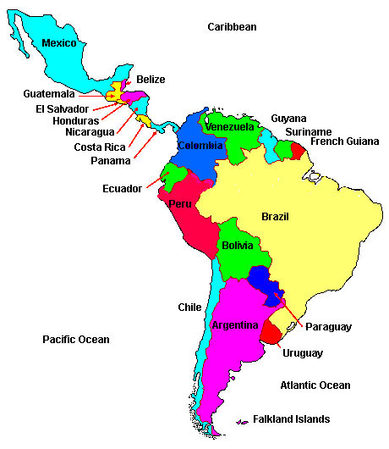

Slide 22
Characteristics/Assumptions
Families do not encourage autonomy
Communicate fluently with peers
Very cooperative with parents and share their value of education
Families are affectionate and want children to succeed
Expectations are often different for males than females
Unusual maturity and responsibility for their age

Slide 23
Learning Opportunities
Cooperative, intellectual peer groups for learning
Encouraging
Provide visual and kinesthetic learning
Provide extensive experience with English and Spanish and use of language at higher levels
Using successful Hispanic Americans as mentors
Including family as an active part of the educational team

Slide 24
S-C-L

Slide 25
What about the Gifted?
Typically underrepresented because of:
Test Bias
Underreferrals by teachers
Deficit-based views of minority groups
Many districts have imposed quotas
Quotas are not the most effective way to do this

Slide 26
How do reach these students?
Giftedness can be developed in EVERY racial and ethnic group
Recognize and further development of those who show potential of higher intellectual development
Stimulating environments
Engage in activities that are both Left and Right brain
Provide intellectually appropriate experience (not just assessments)
Be Aware
http://www.youtube.com/watch?v=uV36efjBKRU

